Slide 1
Network Topologies

Slide 2
Network Topologies
Refers to how various nodes, devices, and connections on your network are physically or logically arranged in relation to each other.
The physical topology of a network refers to the physical layout of the devices, but mostly the cabling and cabling layout.
The primary physical topology categories are bus, ring, star, and mesh.
You must match the physical topology to the type of cabling (twisted pair, coaxial, fiber and so on) that will be installed.
The logical topology defines the logical path on which the signal will travel from on the physical topology.
that is the way in which data accesses the network media and transmits packets across it.
is bound to network protocols and describe how data is moved across the network

Slide 3
Why we need a topology ?
A network's topology affects its capabilities
The choice of one topology over another will have an impact on the
Types of equipment that the network needs
Growth of the network – scalability
Way the network managed

Slide 4
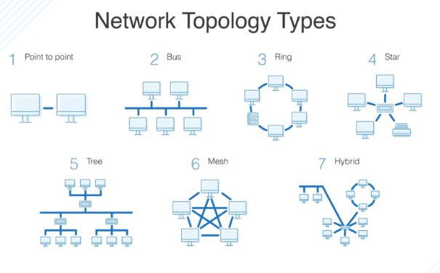

Slide 5
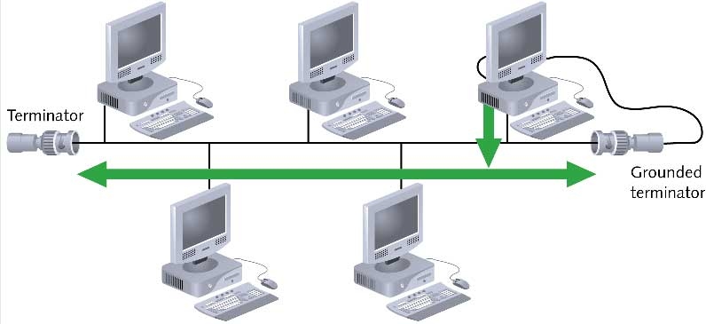

Slide 6
Bus Topology
A Bus topology consists of a single cable—called a backbone— connecting all nodes on a network without intervening connectivity devices
Linear bus
one long cable acts as a backbone to link all the devices in the network
All the device receive the signal.
It describes a multipoint connections
Cable must end with a terminator that absorbs the signal when it reaches the end of the line wire.

Slide 7
Advantages
ease of installation; less cabling
less cabling ; If N devices are connected to each other in a bus topology, then the number of cables required to connect them is 1, known as backbone cable, and N drop lines are required.
Bus topologies are a good, cost-effective choice for smaller networks because the layout is simple, allowing all devices to be connected via a single coaxial or RJ45 cable.
Coaxial or twisted pair cables are mainly used in bus-based networks that support up to 10 Mbps.
The cost of the cable is less compared to other topologies, but it is used to build small networks.
Bus topology is familiar technology as installation and troubleshooting techniques are well known.
If needed, more nodes can be easily added to the network by joining additional cables.

Slide 8
disadvantages
A bus topology is quite simpler, but still, it requires a lot of cabling.
signal reflection at the taps can cause degradation in quality
soln: limit the number and spacing of devices connected to a given length of cable
difficult reconnection (adding new devices) and fault isolation
If the cable experiences a failure, the whole network goes down, which can be time-consuming and expensive to restore
Bus topologies are best suited for small networks because there’s only so much bandwidth, and every additional node will slow transmission speeds.
If the network traffic is heavy, it increases collisions in the network. To avoid this, various protocols are used in the MAC layer known as Pure Aloha, Slotted Aloha, CSMA/CD, etc.
Furthermore, data is “half-duplex,” which means it can’t be sent in two opposite directions at the same time, so this layout is not the ideal choice for networks with huge amounts of traffic.
Security is very low.

Slide 9
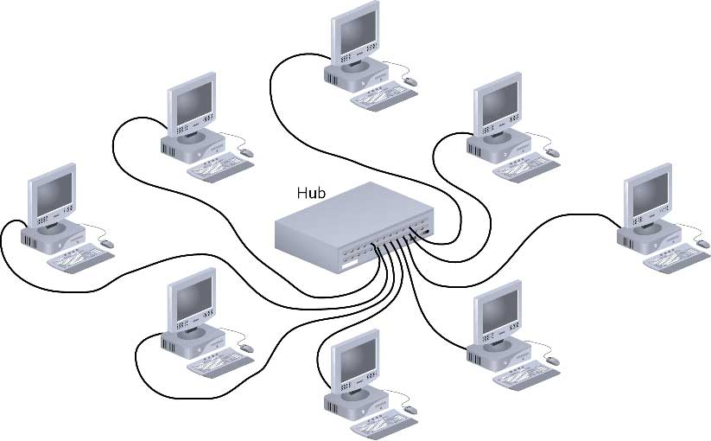
Star Topology

Slide 10
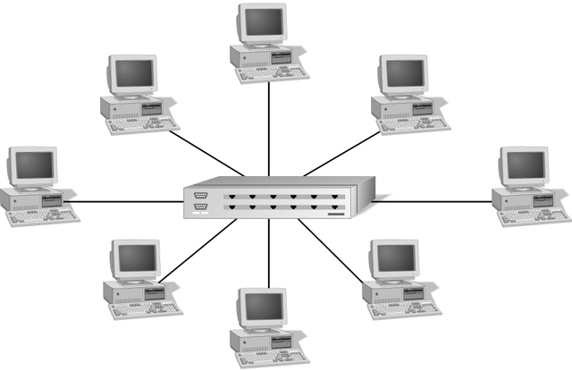
Every node on the network is connected through a central device called hub or switch.
Is the most common Physical topology in Ethernet (LANs)

Slide 11
Any single cable connects only two devices
Cabling problems affect two nodes at most
Requires more cabling than ring or bus networks
More fault-tolerant
Easily moved, isolated, or interconnected with other networks
Scalable

Slide 12
Advantages
Good option for modern networks
Easy to manage
Robust
a failure of a link has no effect on others
devices can be added, removed, and modified without taking the entire network offline. Offers opportunities for expansion
fault identification and isolation are easy
less expensive than mesh (but more expensive than others)
Disadvantages
Single point of failure
Requires more cable length than a linear topology (Bus or Ring)
More expensive than linear bus topologies because of the cost of the concentrators.

Slide 13
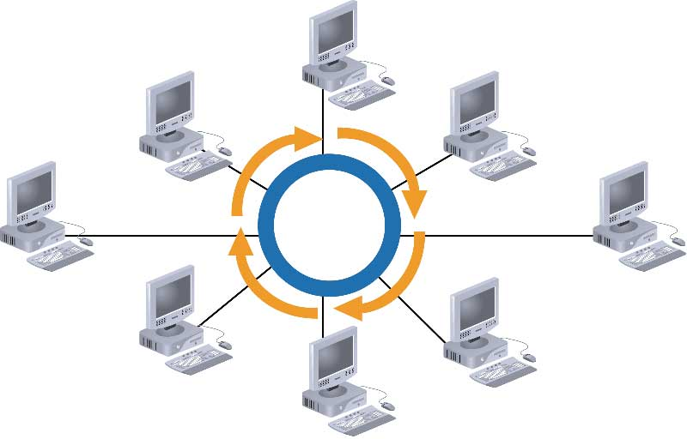
Ring topology

Slide 14
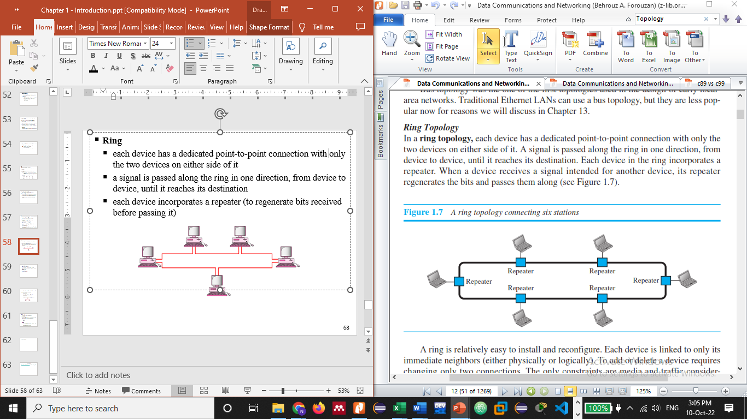
each device has a dedicated point-to-point connection with only the two devices on either side of it (either physically or logically) and forms a circle.
a signal is passed along the ring in one direction, from device to device, until it reaches its destination
each device incorporates a repeater (to regenerate bits received before passing it)

Slide 15
Advantages
Ring networks are moderately easy to install
Equal access for all users
Each workstation has full access speed to the ring
As workstation numbers increase performance diminishes slightly
Cable faults are easily located, making troubleshooting easier
Disadvantages
In a simple ring, a break in the ring (such as a disabled station) can disable the entire network.
Difficult Connections.
Expensive.
Requires more cable and network equipment at the start.
Expansion to the network can cause network disruption.

Slide 16
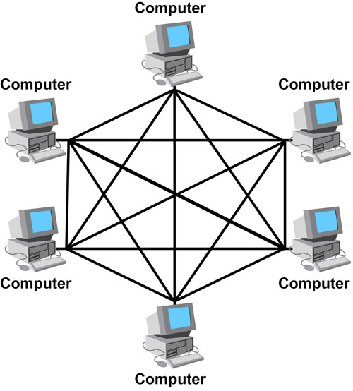
Mesh Topology
every device has a dedicated point-to-point link to every other device
every device must have n-1 I/O ports

Slide 17
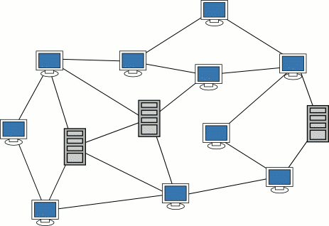
Simple Physical Topologies
Mesh Topology: Each computer connects to every other.
High level of redundancy.
every device must have n-1 I/O ports
Rarely used.
Wiring is very complicated
Cabling cost is high
Troubleshooting a failed cable is tricky
A variation hybrid mesh – create point to point
connection between specific network devices, often
seen in WAN implementation.

Slide 18
Advantages
no traffic problem
robust; a failure of a link has no effect on others
There is the advantage of privacy or security
The network can be expanded without disruption to current uses
Point to point links make fault identification and fault isolation easy
Disadvantages
Requires more cable than the other LAN topologies
Complicated implementation
Installation and reconnection are difficult.
Sheer bulk of wiring can be greater than the available space can accommodate
Expensive

Slide 19
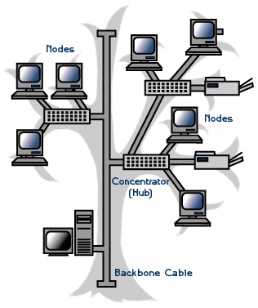
Hybrid Topologies

Slide 20
Hybrid Topologies
One example of Hybrid Topology is Tree topology
Tree topology is a combination of Bus and Star topology.
It consists of groups of star-configured workstations connected to a linear bus backbone cable.
If the backbone line breaks, the entire segment goes down
An example of this network could be cable TV technology

Slide 21
Choosing a Topology
BUS
network is small
network will not be frequently reconfigured
least expensive solution is required
network is not expected to grow much
STAR
it must be easy to add/remove PCs
it must be easy to troubleshoot
network is large
network is expected to grow in the future
RING
network must operate reasonably under heavy load
higher speed network is required
network will not be frequently reconfigured

